Slide 1
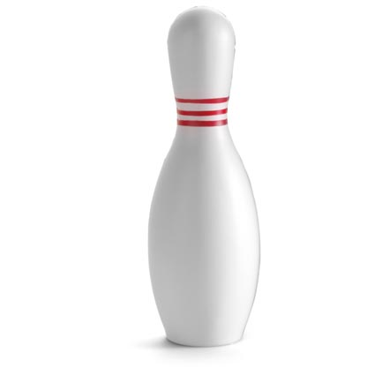
RTI Triangle
Grade/Course/Subject (place)
_____________________________
Curricular Lens:
_____________________________
Competency Lens:
_____________________________
Students who need the most support
Tier 3
Tier 2
Students who need the most challenge
Tier 1
Curricular
Competency

